Slide 1
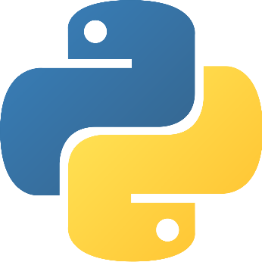

Python for: Data Science

Slide 2

Python
Python is an open source scripting language.
Developed by Guido Van Rossum in late 1980s
Named after Monty Python comedy group.
Python supports multiple programming paradigms, including object-oriented, imperative and functional programming or procedural styles.

Slide 3

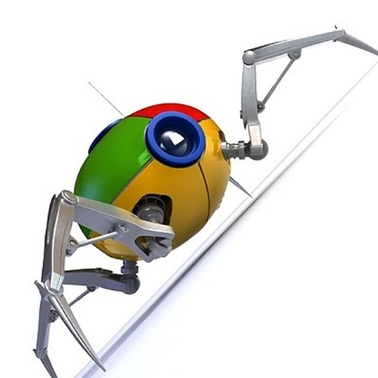
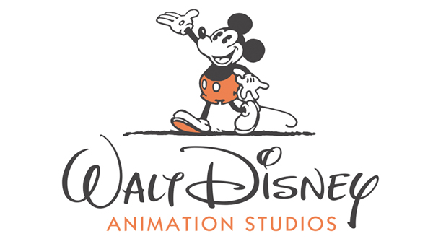


Who uses Python?
Google: Many components of the Google spider and search engine are written in Python.
Yahoo Groups
Yahoo Maps
Battlefield 2
Civilization 4
Walt Disney Feature Animation
National Weather Service
Red Hat
Pardus
And many more…

Slide 4
Why Do Data Scientists Love Coding in Python?

Slide 5
1. Large community = Documentation = Brainpower - With Python, you can find a large (and still growing!) active community. If you get lost you can rely on a this large community of experts to help you find a proper solution for questions related to Data Science and Data Analysis.
Thorough and complete:
Official Tutorial: http://docs.python.org/tutorial/
Language Reference: http://docs.python.org/reference/
Daily round-up of py news. Active user engagement.
Pythonware Daily: http://www.pythonware.com/daily/
Planet Python: http://planet.python.org/
A very high chance of python related query getting answered in seconds! As is StackOverflow.
Irc Node: http://www.python.org/community/irc/
StackOverflow: stackoverflow.com/questions/tagged/python?sort=newest

Slide 6
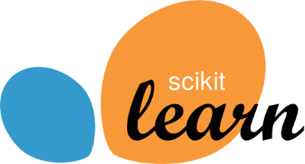
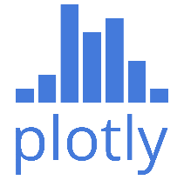

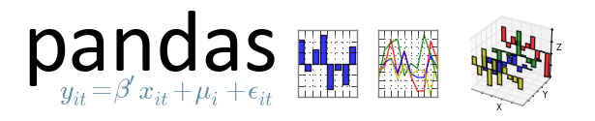
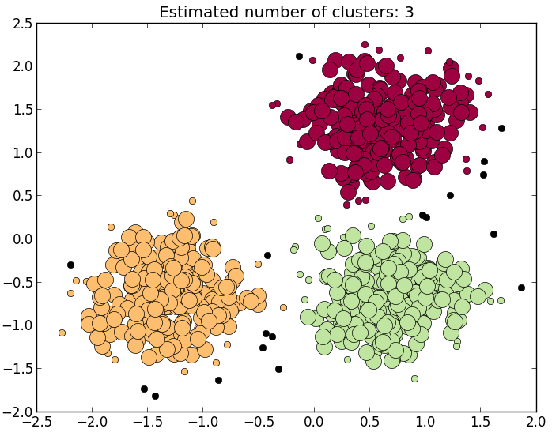
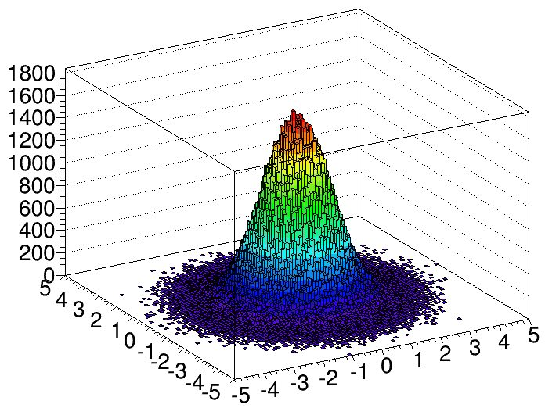
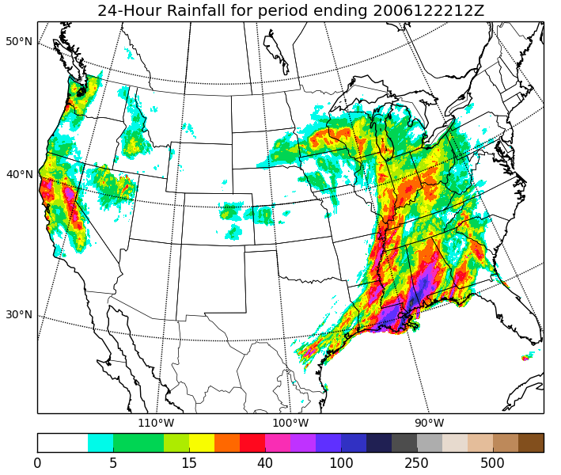
2. Growing Data Analytics Libraries:
Scientific Computing: NumPy, SciPy, Pandas, IPython Notebook
Machine Learning: Scikit-learn, Shogun, PyLearn2
Plotting and Visualization: matplotlib, ggplot, plotly

Slide 7
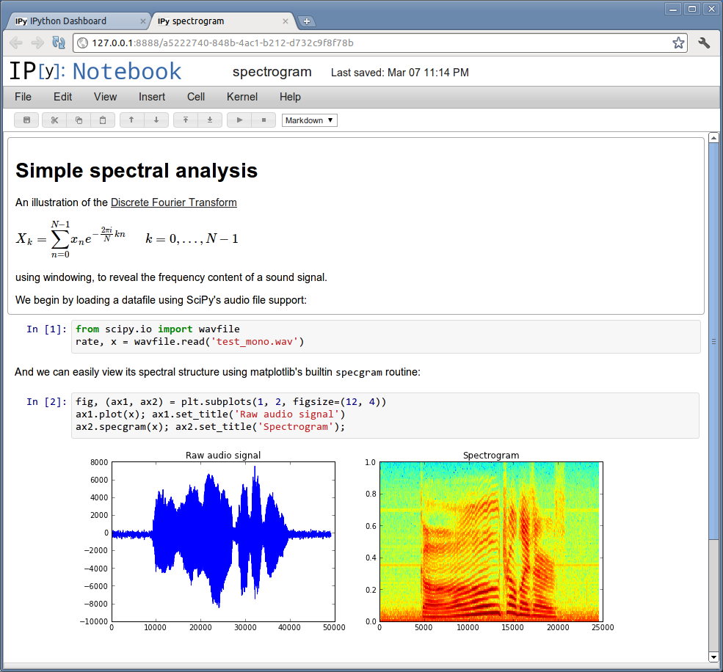
3. IPython-Notebook
The IPython Notebook is an interactive computational environment, in which you can combine code execution, rich text, mathematics, plots and rich media, as shown in this example session:

Slide 8
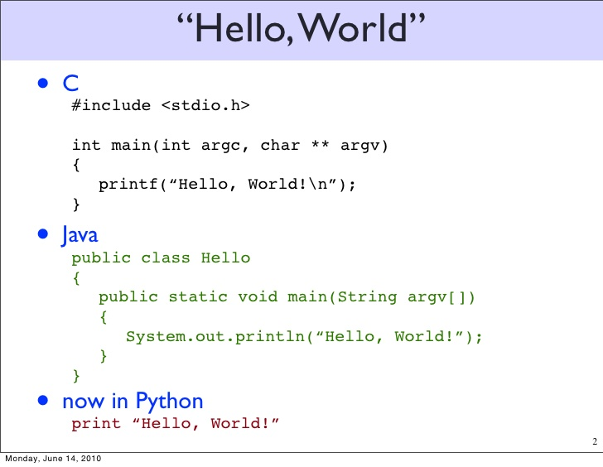
4. Easy to learn & Concise: Syntax is user friendly, consistent and elegant.
Generally, Python code is 70% shorter than the same in Java.
Python has a better and easier syntax than other OO languages.

Slide 9
How to Install Python:
How to Install Python?
Go to: https://www.python.org/downloads/
Choose appropriate installer according to you OS, download and install it.
Bam! You’re done.
(Demo Some Code)

Slide 10
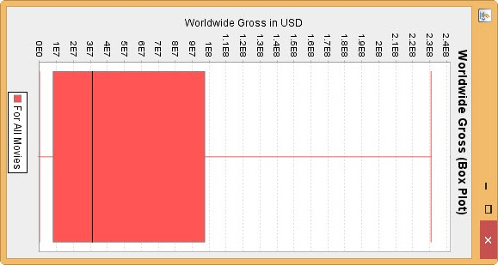
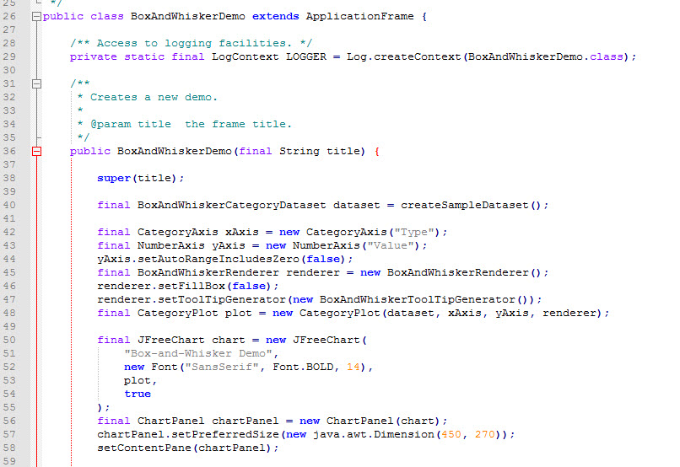
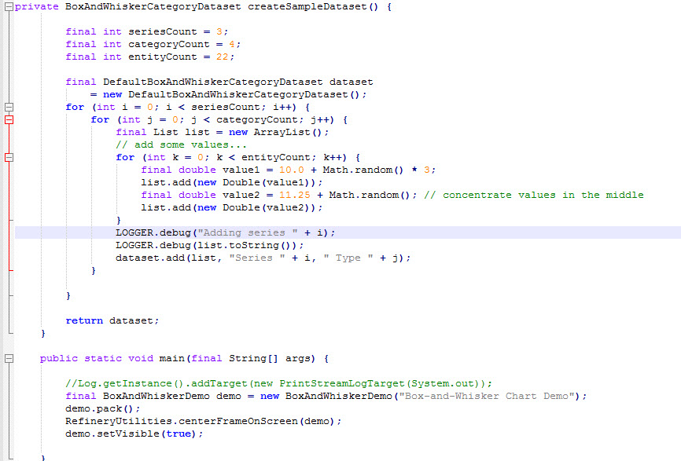
More on Conciseness:
Box Plot in Java using JFreeChart library:

Slide 11
Demo Box Plot in Python

Slide 12
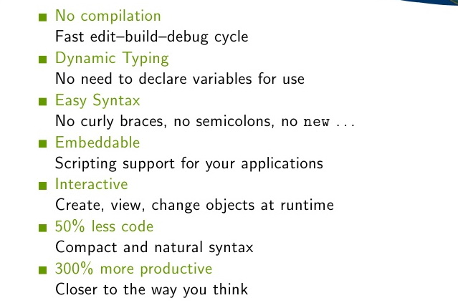
Python vs. Java (or C++ or C#)

Slide 13
R vs Python for Data Science
http://goo.gl/EpWzLO

Slide 14
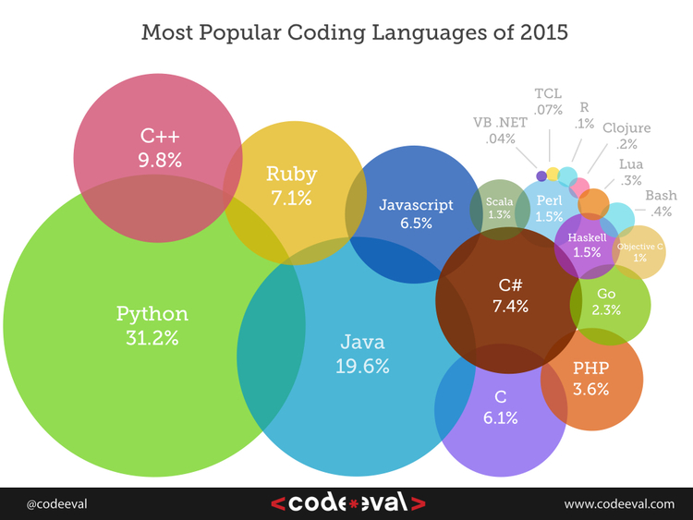

Slide 15
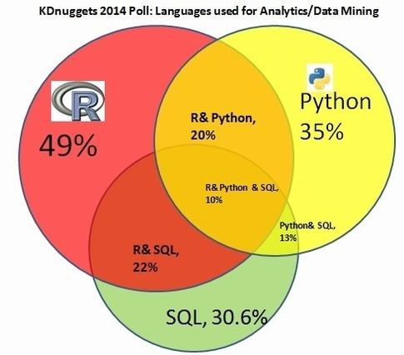

Slide 16
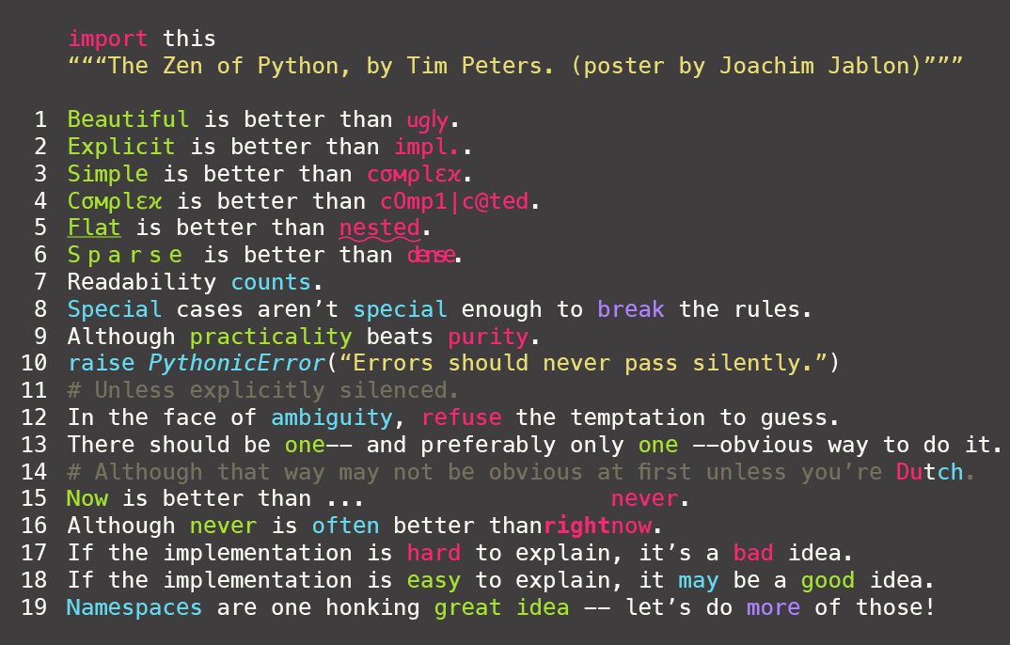
Zen of Python: Poem written by Tim Peters

Slide 17
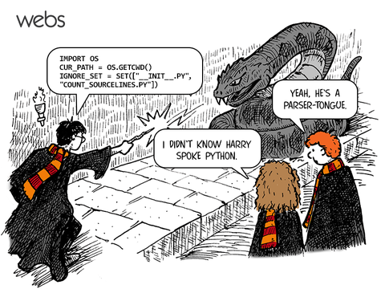
Thank You!

